Slide 1

Music Insights
TEAM CLOUD CODERS

Slide 2
Team Members
Megha Singha Roy
Pavan Shetti
Sanketh Shinde
Thrishala NP
Sudeep S

Slide 3
Project Overview
Builds a distributed ETL pipeline to process users music listening data.
Uses AWS Glue to clean and transform raw data.
Final metrics are queried through Athena for insights.

Slide 4
Use Cases
Measure User Engagement:
  Measure total listens, users, and duration.
Top Songs
  Find top 3 songs in each genre daily.
Top Genres
  Identify 5 most popular genres overall.

Slide 5
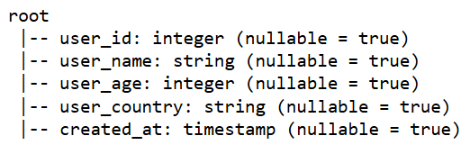
Input Data Overview
Dataset source - S3
Data format - csv
Sample schemas
Users schema

Slide 6
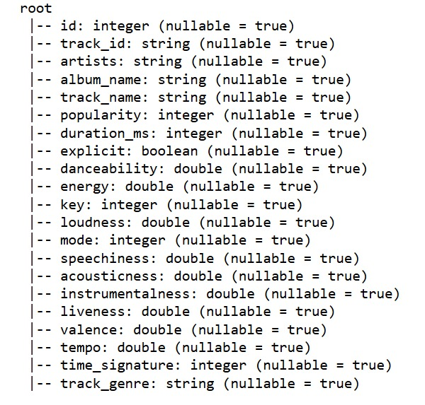
Input Data Overview
Songs Schema

Slide 7
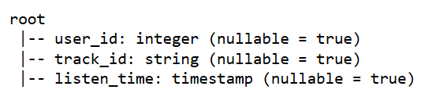
Input Data Overview
Streams Schema

Slide 8
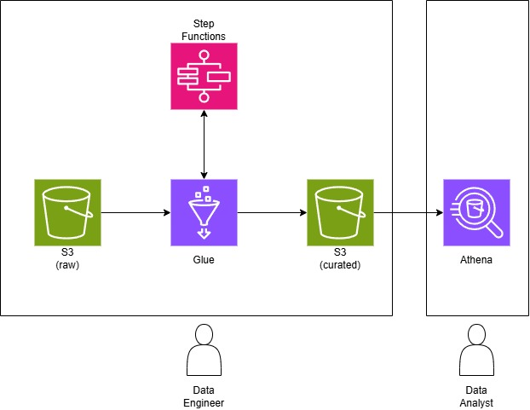
High-Level Architecture
AWS services used: S3, Glue, Athena, Step Functions

Slide 9
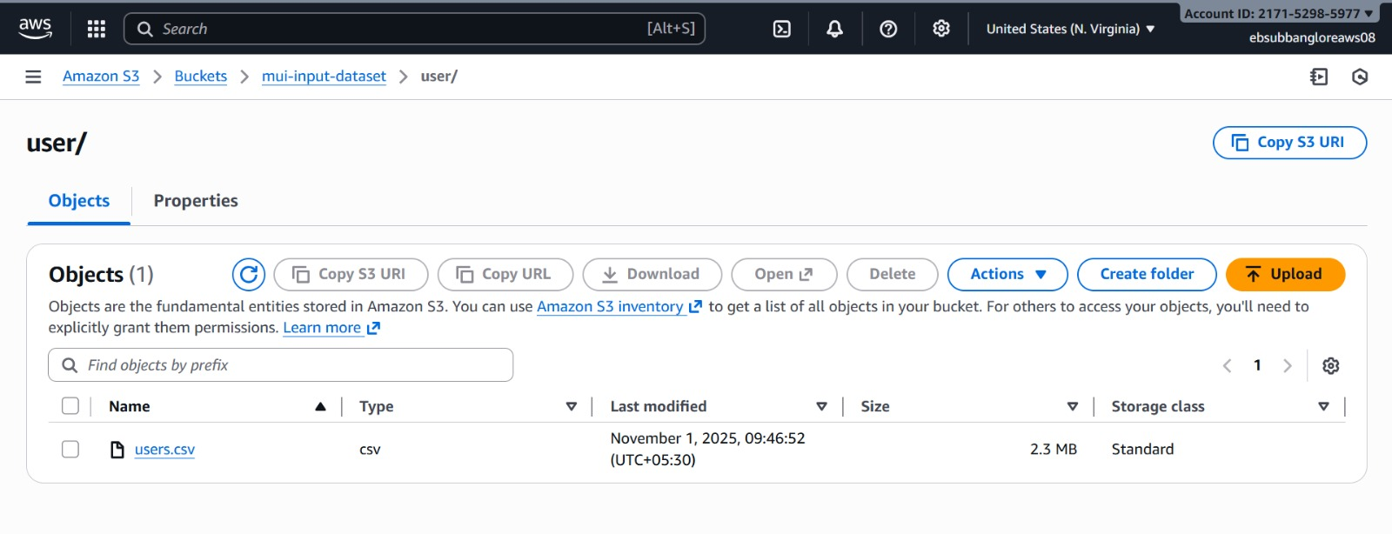
Snapshot
Loading data into S3

Slide 10
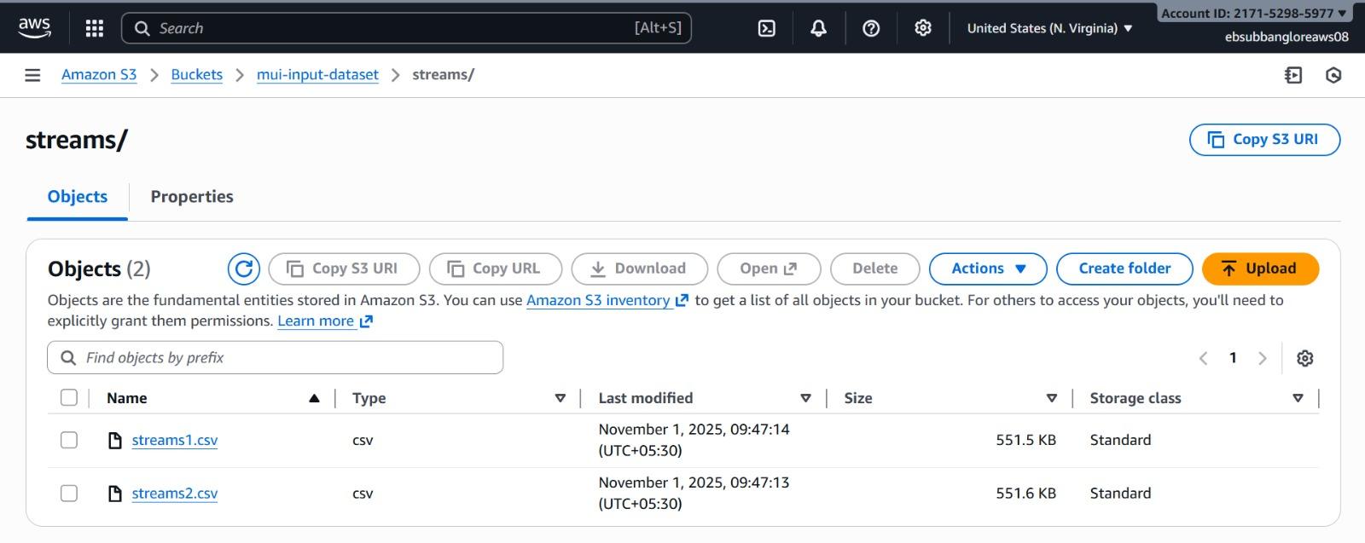
Snapshot
Loading data into S3

Slide 11
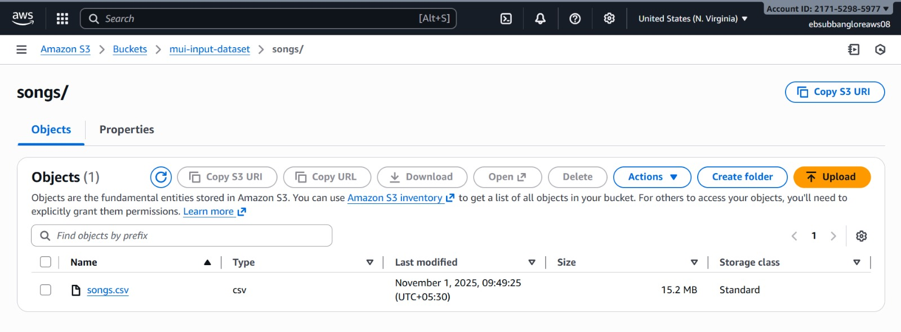
Snapshot
Loading data into S3

Slide 12
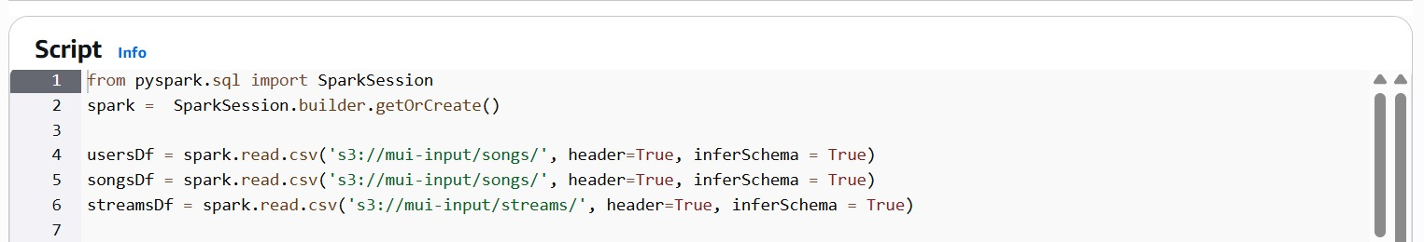
Snapshot
AWS Glue

Slide 13
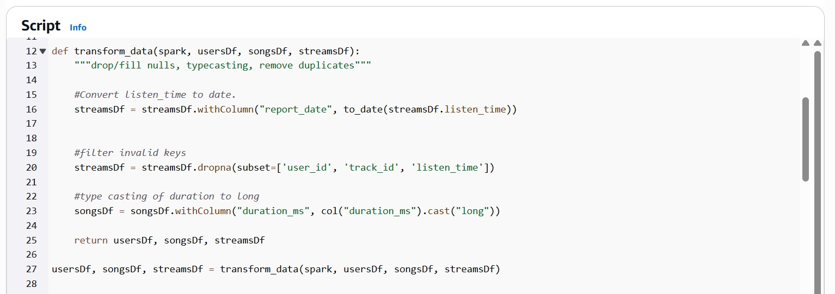
Snapshot
AWS Glue

Slide 14
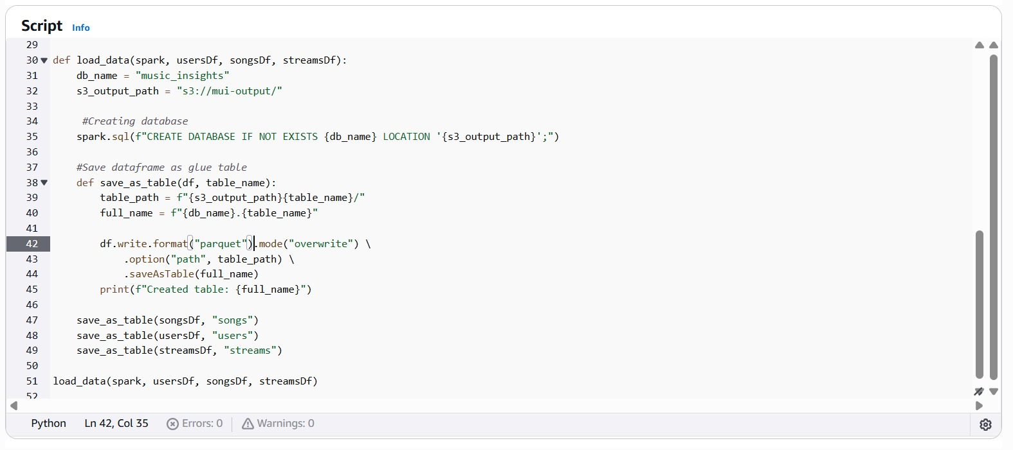
Snapshot
AWS Glue

Slide 15
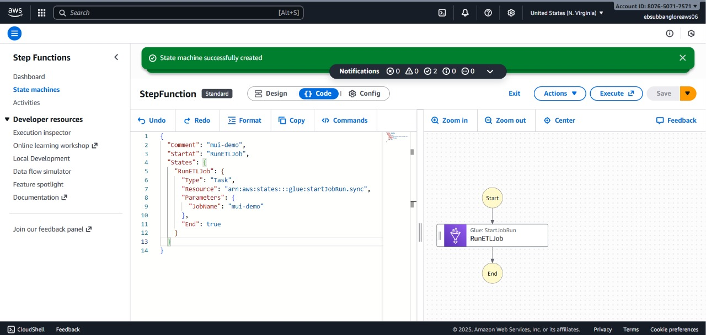
Snapshot
Step Functions

Slide 16
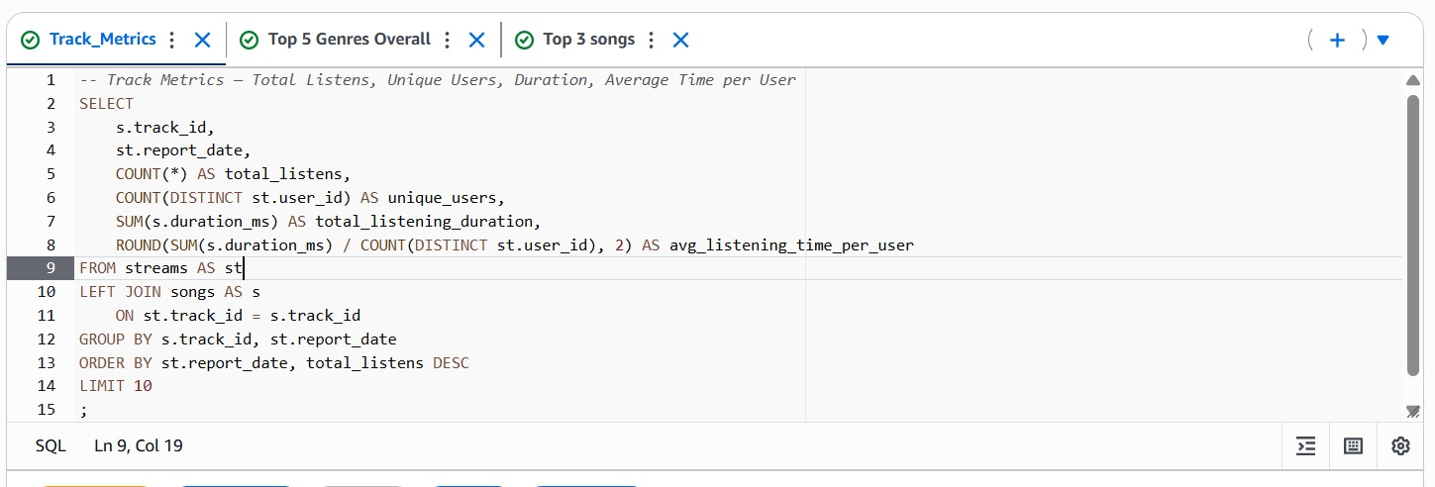
Snapshot
Track metrics

Slide 17
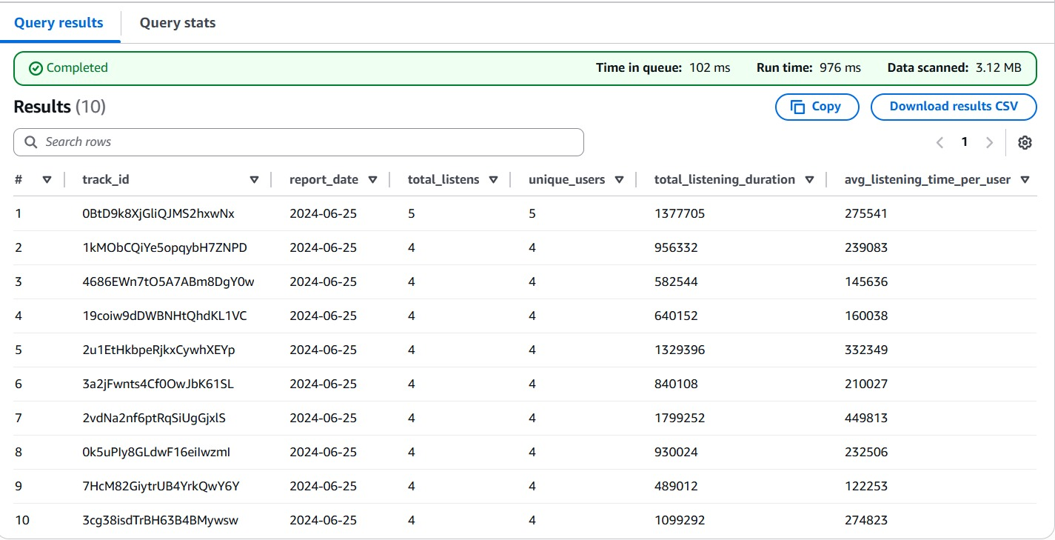
Snapshot
Result of Track Metrics

Slide 18
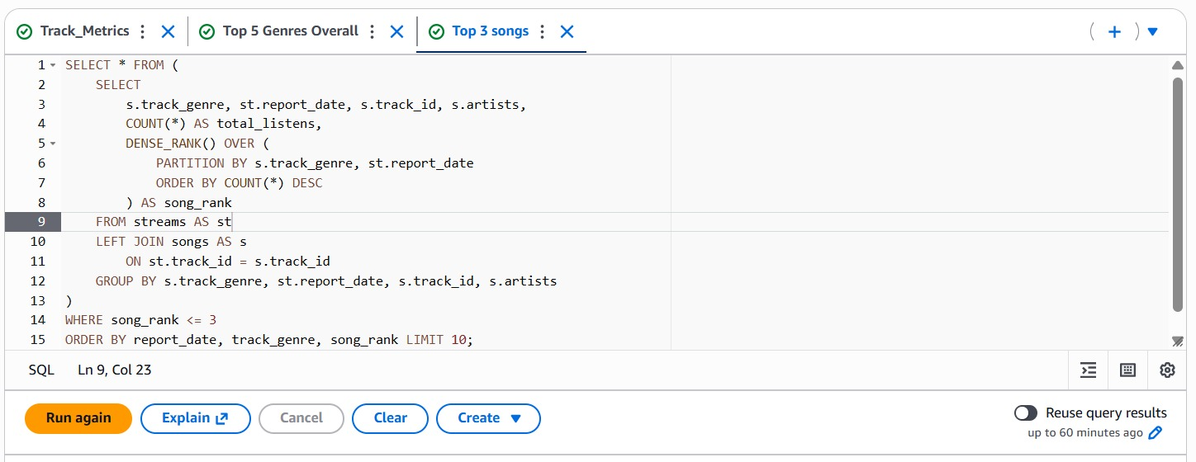
Snapshot
Top 3 songs

Slide 19
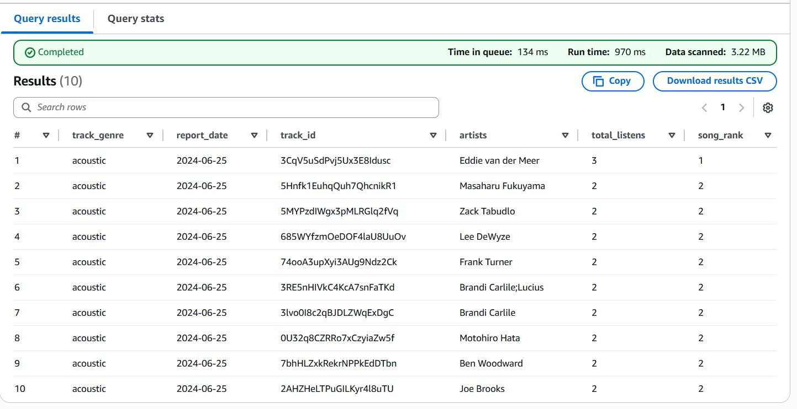
Snapshot
Result of Top 3 Songs

Slide 20
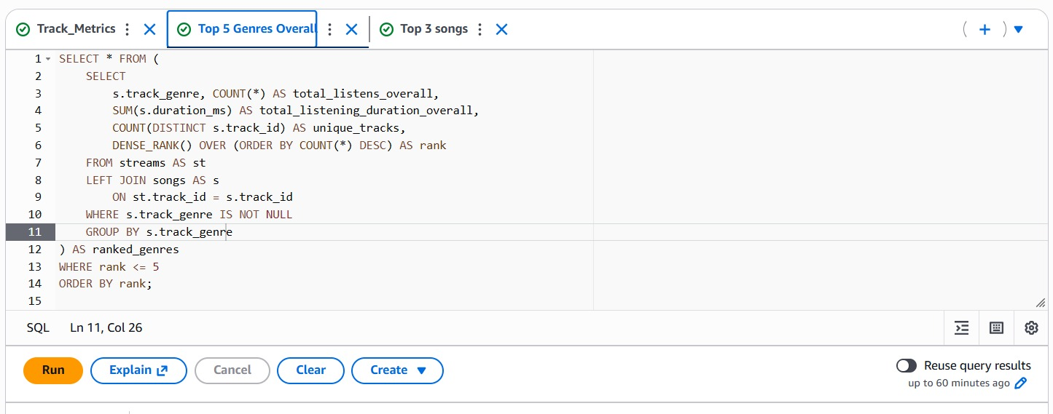
Snapshot
Top 5 Genres

Slide 21
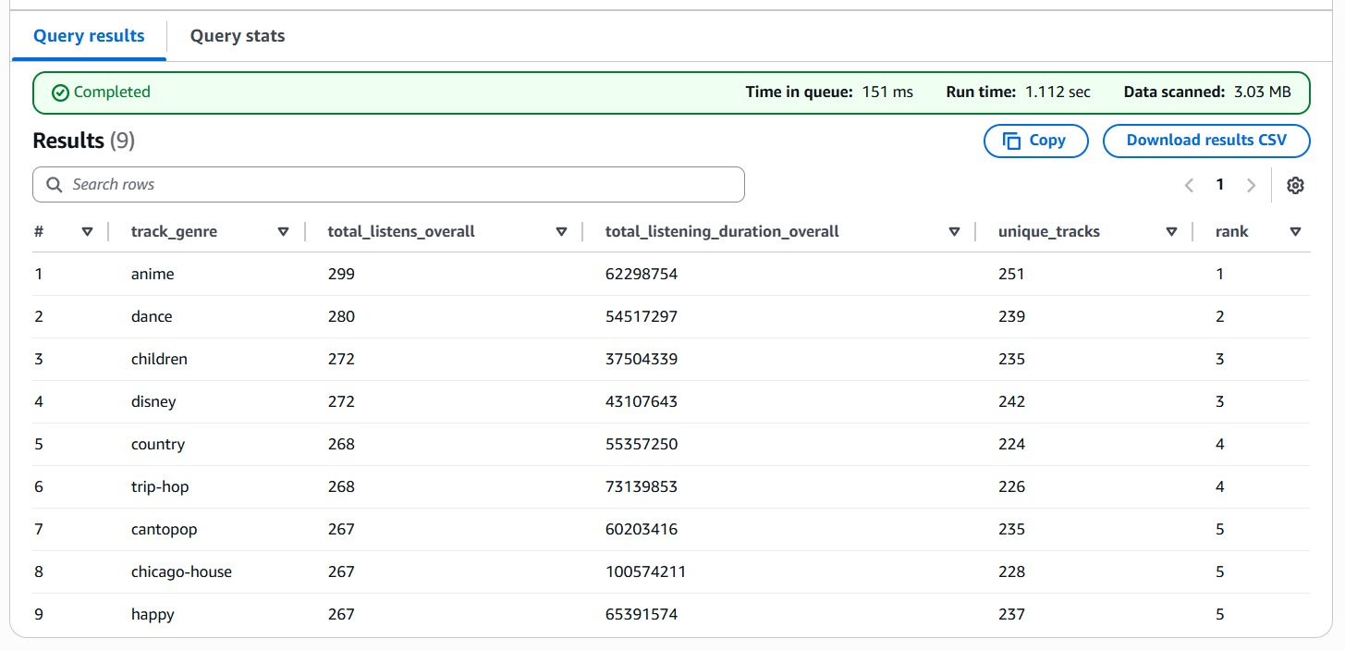
Snapshot
Result of Top 5 Genres

Slide 22
Analytical Insights
Identified Top Songs per Genre (daily) to track music popularity.
Highlighted Top Genres overall, showing user listening trends.
Calculated user engagement metrics - total listens, unique users, and listening duration.

Slide 23
Future Scope
Real-Time Data Processing
Automated Data Ingestion and Crawling
Integrate Boto3 SDK

Slide 24


